Slide 1
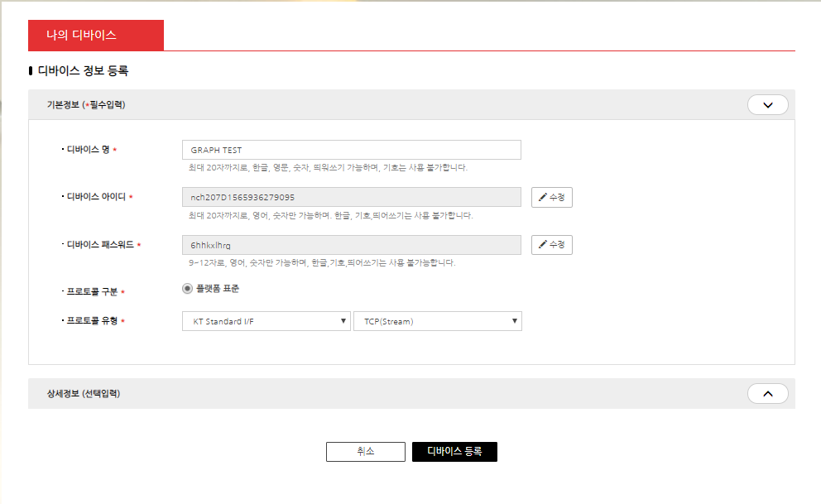
1. Process of Register Device
Input Device Name
Click Button

Slide 2
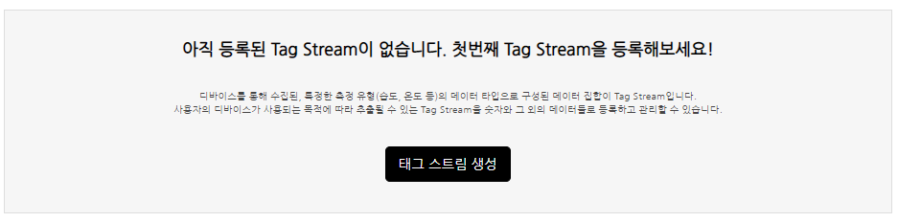
1. Process of Register Device
Click Button

Slide 3
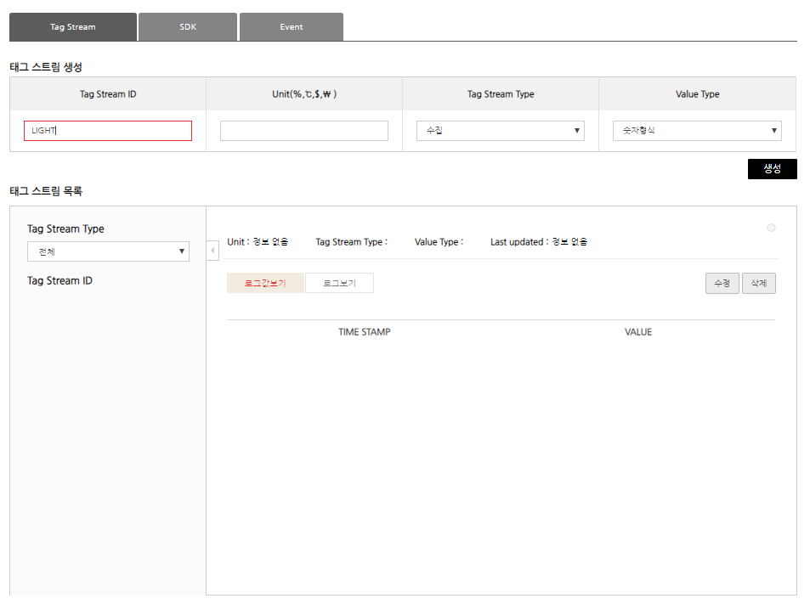
Select Collect
int
Insert Tag Stream ID : Temperature
Click button

Slide 4
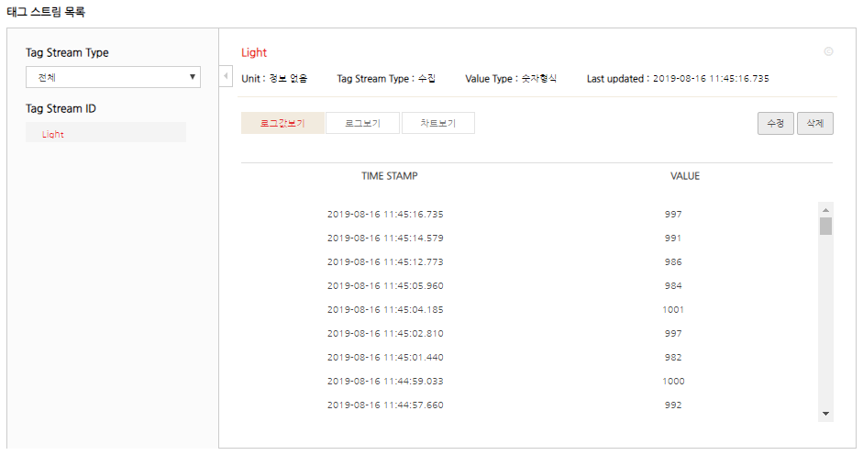
View Log
View Chart

Slide 5
